Slide 1
Threads: putting the pieces together
CS 241
February 24, 2012
Copyright © University of Illinois CS 241 Staff

Slide 2
Goals for today
Pre-lecture quiz
When should you use threads?
Building a parallel application: primality testing

Slide 3
Pre-lecture quiz

Slide 4
1. get_favorites: does it work?
No. get_favorites() returns a pointer to memory which is destroyed before main() gets a chance to use it.
No. main() might try to print out the numbers before the get_favorites thread finishes.
No. 42 and 3.14159... are not, in fact, two of your favorite numbers.
No. In main(), the parameter passed to pthread_join() should just be my_fav instead of &my_fav, because my_fav is already a pointer.
No. main() should not call free(my_fav), because main() did not allocate the memory. Remove the free() and it will work.
Yes.

Slide 5
2. What’s the possible output?

Slide 6
3. User-level vs. kernel-level threads

Slide 7
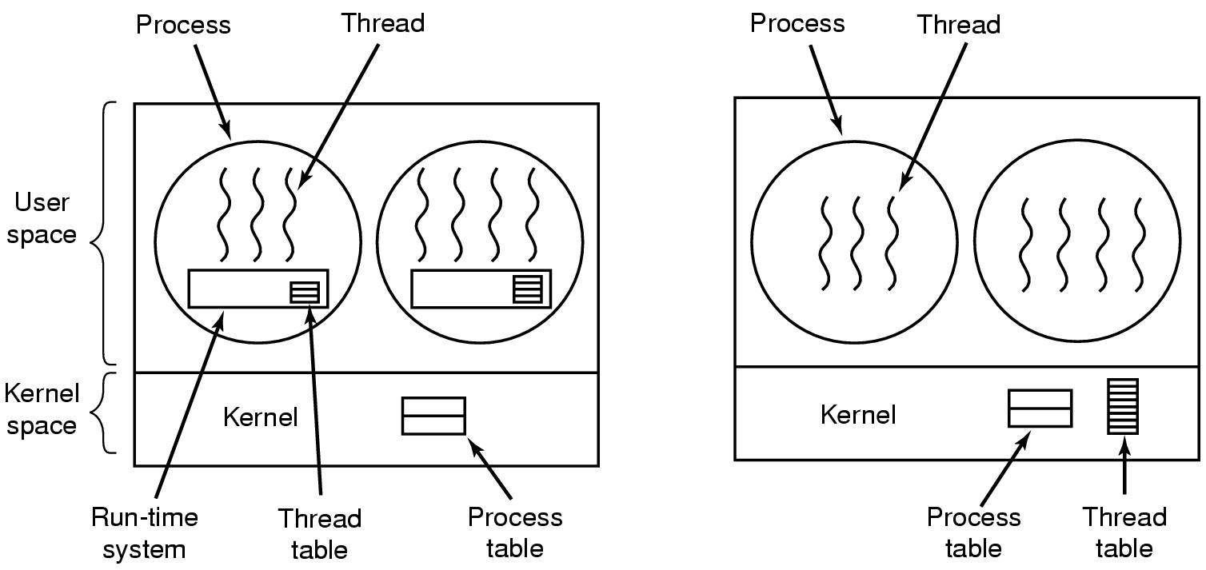
User vs. Kernel Threads
User-level Threads
Kernel-level Threads

Slide 8
Trade-offs?
Kernel thread packages
Each thread can make blocking I/O calls
Can run concurrently on multiple processors
Threads in user-level
Fast context switch
Customized scheduling
No need for kernel support
Q: Is kernel thread context-switching faster than process context-switching? Why or why not?
Both need to switch to kernel mode, swap registers, change program counter, ...
Kernel threads don’t need to change virtual memory spaces

Slide 9
When to use threads

Slide 10
Why threads?
Processes do not share resources well
Why?
Process context switching cost is high
Why?
Therefore ... Threads: light-weight processes
Shared address space
Easier
communication,
less protection
Faster creation,
switching,
communication,
termination

Slide 11
Tasks suitable for threading
Has multiple parallel sub-tasks
Some sub-tasks block for potentially long waits
Reading off disk
Waiting for user input
Waiting for other “asynchronous” events (could arrive at any time)
Can you implement these without threads?
Yes, but threads help modularize
Or, some sub-tasks use many CPU cycles
Ideas? How about...

Slide 12
Putting it all together: primality testing
Notes:
Suggestion: follow along and do the coding together.

Slide 13

Primality testing goals
Decide if an integer is prime
Input: integer
Output: prime, or composite with factors
Exploit parallelism
Testing primality can be slow
My laptop has multiple cores
the primes (x axis) in binary (y axis) [MathWorld]

Slide 14
Attacking the problem
Serial algorithm
Iterate through possible factors f, testing if f divides x
Easy to parallelize
Lots of very small chunks of independent work
Technical term: embarrassingly parallel

Slide 15
input: is 901 prime?
main
thread 1
thread 2
thread 3
check 2-10
check 21-31
check 11-20
Result: ?

Slide 16

Same design pattern: Simulate the universe
[Millennium Simulation / Virgo Consortium]
Notes:
n-body simulations ... This is from a large-scale simulation of the birth of the universe:
http://en.wikipedia.org/wiki/File:AstroMSseqF_063aL_(18135101).jpg
Mpc is megaparsecs. /h is some physical constant representing uncertainty about rate of expansion of the universe.
Obviously this is a very complex problem. It is not just like testing for primes. But I believe they simulate n-body problems by iterating over timesteps, and in each timestep you slice it into physical regions (or bodies) with each ‘thread’ handling one body. So at a very high level, it is the same pattern.

Slide 17
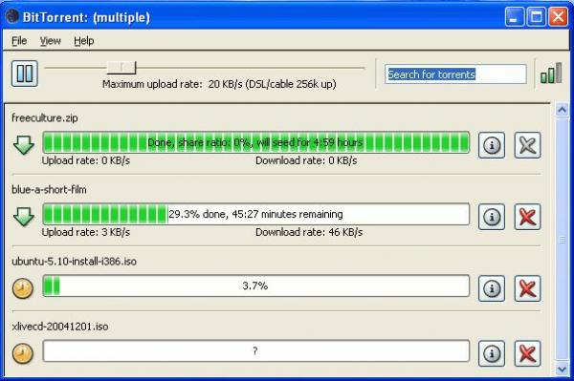
Same design pattern: Download movies

Slide 18
Same design pattern: Render movies
Lucasfilm data center

Slide 19
Decision: processes or threads?
Processes
Exploit parallelism successfully
Separate memory space: good for protection
Threads
Exploit parallelism successfully
Shared memory space: good for working together

Slide 20
Planning the thread operations
main
thread 1
thread 2
thread 3
create,
pass arguments
check 2-10
check 21-31
wait for completion
(join)
check 11-20
return results
Result: ?

Slide 21
Away we go...

Slide 22
Parallel performance
Notes:
This air has 2 cores, each with two virtual cores (Hyper-Threading)

Slide 23
Parallel performance

Slide 24
Next time: Scheduling
For real this time...

Slide 25
[Hidden slide] Here’s what I did:
Start with template code
Code it in real time in lecture
Stop occasionally having written stubs, compile, make sure it works
Run it on some big primes for one thread
Increase # of threads, see what happens
Ask: So, how many cores do I have on my machine?
Then, show it. On mac, open Activity Monitor, double click on the CPU graph to make it bigger.
Take-aways:
Mechanics of passing complex args, joining, etc.
Parallelism helps!
But, you don’t get optimal speedup and that is what you should expect in general.

